Slide 1



Big Data Computing
Big data computing refers to the processing and analysis of large and complex datasets, often characterized by the three Vs: volume, velocity, and variety. It involves using specialized technologies and techniques to extract valuable insights and knowledge from massive amounts of data that traditional data processing methods cannot handle efficiently.
Va
by Vaarija Kavuri

Slide 2
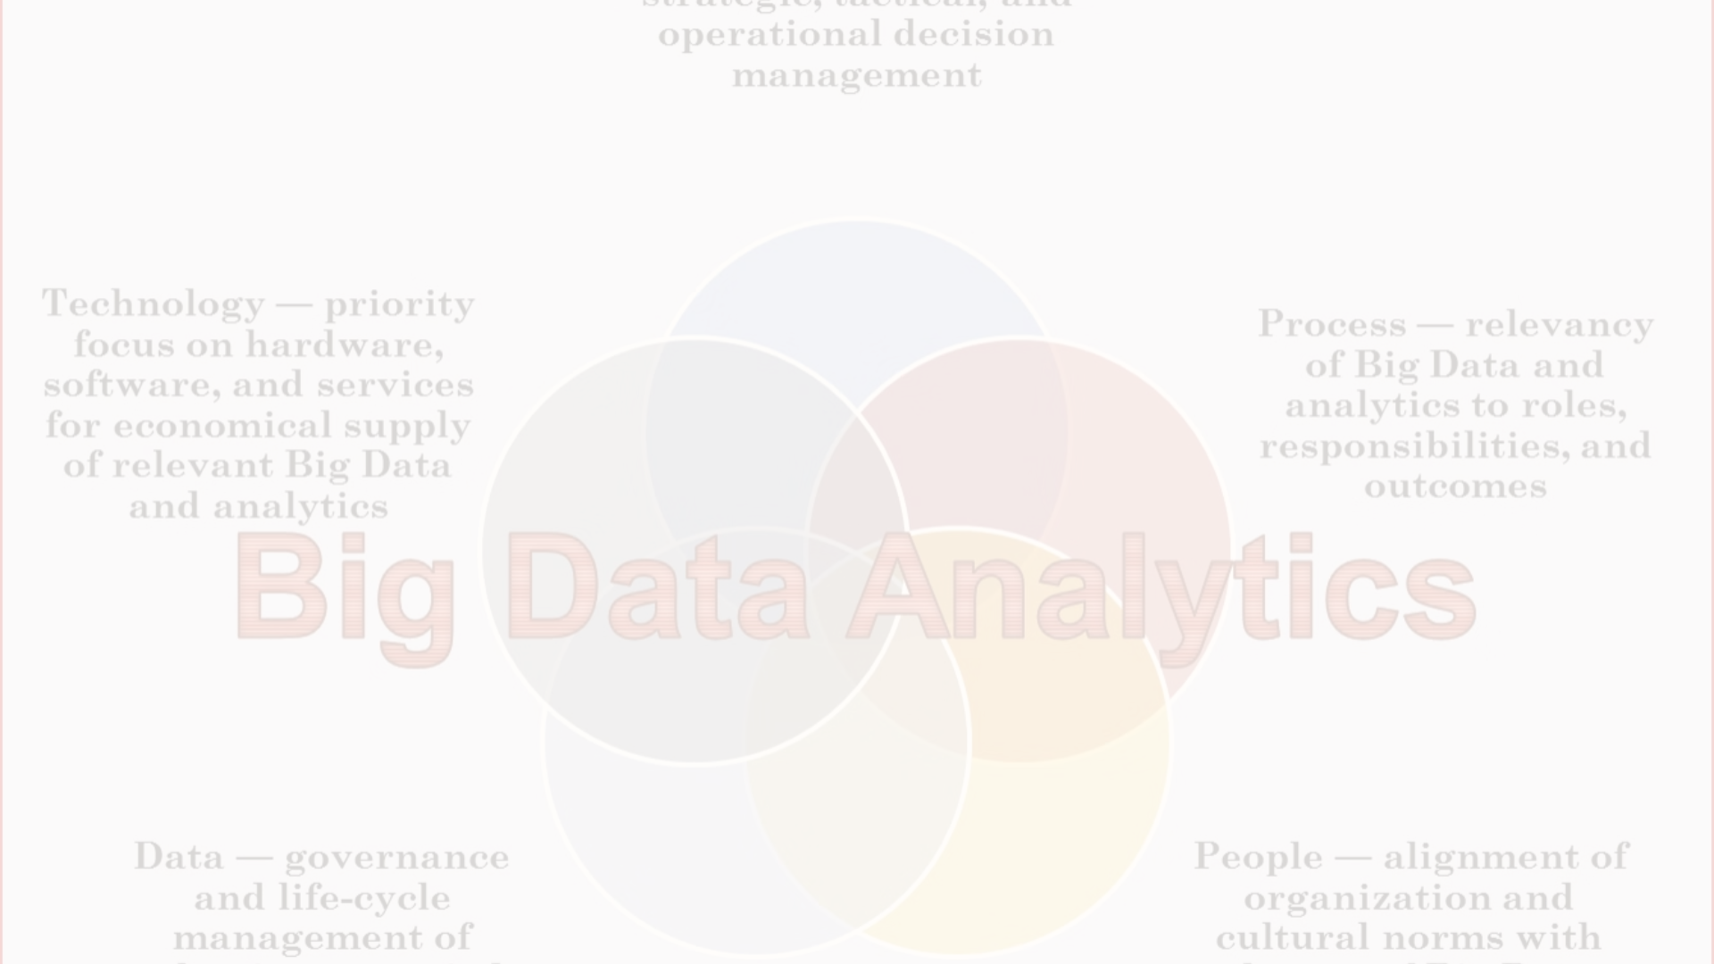
Key Components of Big Data Computing
1
Data Storage
Big data systems require scalable and distributed storage solutions capable of handling massive volumes of data. Technologies such as Hadoop Distributed File System (HDFS) and cloud-based storage services provide storage infrastructure for storing and managing big data.
2
Data Processing
Big data processing frameworks such as Apache Hadoop, Apache Spark, and Apache Flink enable distributed and parallel processing of large datasets across clusters of commodity hardware. These frameworks support batch processing, real-time stream processing, and interactive querying to perform various data analysis tasks.
3
Data Analysis and Machine Learning
Big data analytics tools and machine learning algorithms are used to derive insights, patterns, and trends from big data. These tools enable organizations to perform tasks such as predictive analytics, anomaly detection, and sentiment analysis to gain actionable insights from their data.

Slide 3
Oracle VirtualBox
Cross-platform Compatibility
Snapshot Support
VirtualBox is available for Windows, macOS, Linux, and Oracle Solaris hosts, making it accessible across different operating systems.
Users can take snapshots of virtual machine states, enabling them to save and restore VM configurations at specific points in time, facilitating experimentation and rollback to previous states.
Hardware Virtualization Support
It utilizes hardware-assisted virtualization technologies such as Intel VT-x and AMD-V, allowing for efficient execution of virtual machines with near-native performance.
Flexible Networking Options
VirtualBox offers various networking modes, including NAT, bridged, internal, and host-only networking, allowing users to configure network connections as per their requirements.

Slide 4

Linux OS
1
Open-source Nature
2
Multi-user and Multi-tasking Support
Linux is distributed under open-source licenses, allowing users to access and modify its source code as per their requirements.
Linux supports concurrent execution of multiple processes and provides robust user and permission management features, making it suitable for multi-user environments.
3
Modularity
Linux is composed of modular components, enabling users to customize and optimize the operating system according to specific needs and preferences.

Slide 5
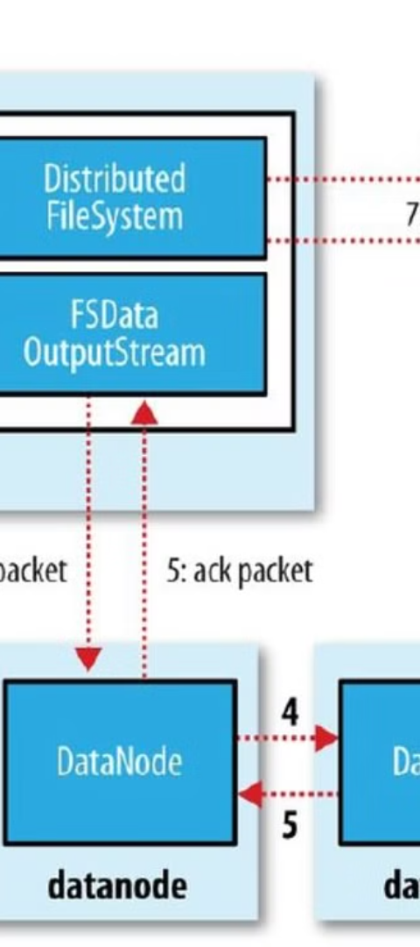
Hadoop
HDFS (Hadoop Distributed File System)
Purpose of Hadoop
The primary purpose of Hadoop is to enable efficient storage, processing, and analysis of vast amounts of data, including structured, semi-structured, and unstructured data.
HDFS is the primary storage system used by Hadoop, designed to store large datasets across distributed clusters of commodity hardware in a fault-tolerant manner.

Slide 6
Advantages of Hadoop in Big Data
1
Scalability
2
Fault Tolerance
3
Cost-effectiveness
Hadoop can scale horizontally to accommodate growing data volumes by adding more nodes to the cluster, ensuring seamless expansion without significant performance degradation.
Hadoop's distributed architecture replicates data across multiple nodes, providing fault tolerance against hardware failures and ensuring data availability and reliability.
Hadoop leverages commodity hardware and open-source software, making it a cost-effective solution for processing large datasets compared to proprietary systems.

Slide 7
Commands for HDFS
I
II
III
Create directory structure in HDFS
Move file from local Unix/Linux machine to HDFS
View contents of files in HDFS
hdfs dfs -mkdir -p /path/to/directory
hdfs dfs -cat /path/to/hdfs/file
hdfs dfs -put /path/to/local/file /path/to/hdfs/directory

Slide 8
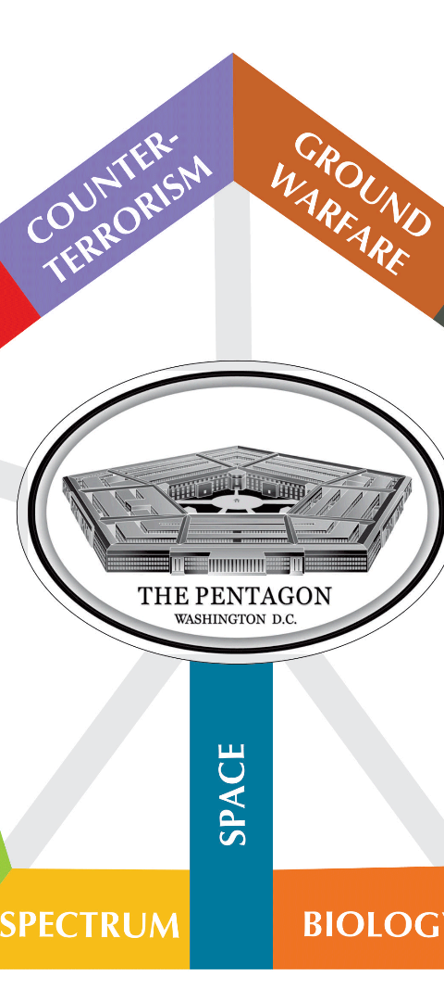



Conclusion
Big Data Computing
Enables organizations to unlock the value of their data by processing, analyzing, and interpreting large and diverse datasets to make data-driven decisions and gain competitive advantages in various domains.
Oracle VirtualBox
Provides a platform for creating and managing virtual machines within which various guest operating systems can be installed and run.
Linux OS
Renowned for its stability, security, and flexibility, making it a popular choice for servers, embedded systems, and desktop computers.

